Slide 1
BUDGET MANAGING FOR FAMILY EXPENDITURE​
POTHABOLU REDDY SEKHAR
192011326
CSE
CSA3731- SOFTWARE TESTING FOR ANDROID APPLICATIONS
31/01/2023

Slide 2
Project Includes
Abstract
Objective
Proposed System
Flow chart
Concept map
No of Test Cases
Apps and Tools Installation
Appium Server
Implementing Testing
Test Case Outcomes
Conclusion

Slide 3
Abstract
BUDGET MANAGER consists of management of daily expenses.
It consists of expenses and revenues.
We can set the budget for certain period of time.
It Can Access Camera to Save the picture of Bill.
Based on the expenses and revenue we can calculate the budget.

Slide 4
Objective
To Test all possible Test Cases of Budget manager application.
To find All positive and Negative Outcomes of the application.

Slide 5
Proposed Work
Budget Manager is Tested using Appium Software.
Revenue , Expense , Bills and Camera will be Tested.
To test Firstly , Install Android Studio , IntelliJ and Appium Software.
Develop Budget Manager Application in Android Studio.
Run the Application using Android Studio Emulator.
Test the positive and Negative outcomes in Appium Software.

Slide 6
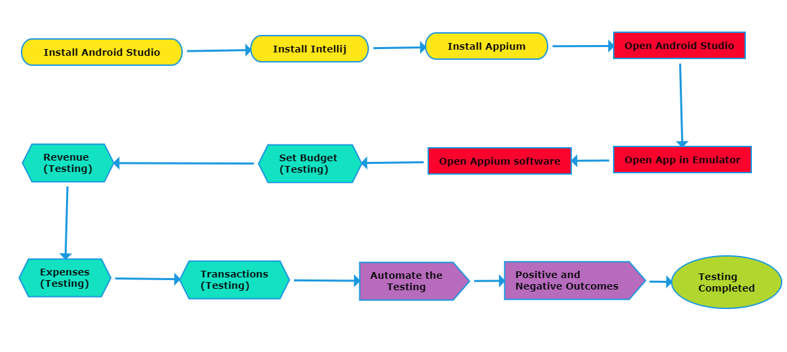
Data Flow Diagram

Slide 7
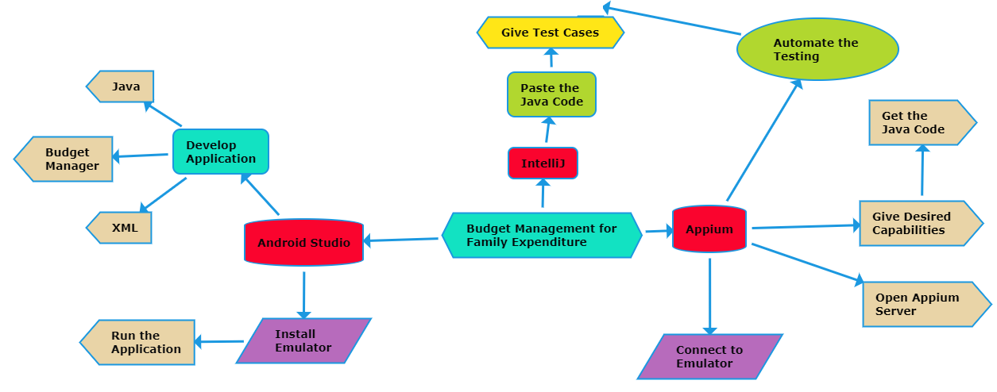
Concept Map

Slide 8
No Of Test Cases
Revenue
Expense
Budget Date
Receipt
Bills
User Input
Set Budget
Transaction
Import/Export Budget
Access Camera/Calendar

Slide 9



Applications Used
APPIUM
INTELLIJ
ANDROID STUDIO

Slide 10
Apps and Tools
Appium
Open source Automation tool.
Automation Framework.
Automates different types of mobile applications testing.
It can test web , Native and Hybrid application.
It supports multiple programming languages.
(Java , python , ruby and many more )
6.It works on Emulator as well as Real Devices.

Slide 11
Apps and Tools
Android Studio
It is Integrated development Environment.
It has fast Emulator for App Testing.
Used to Develop applications for Android devices.
It is an open source software.

Slide 12
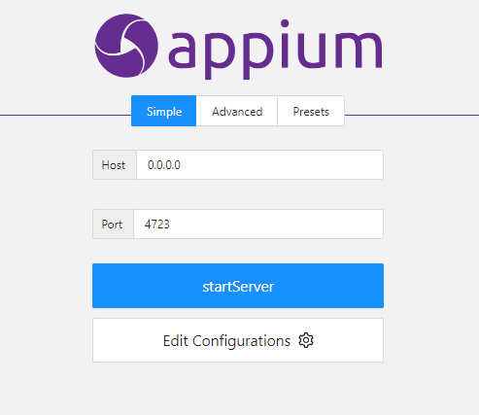
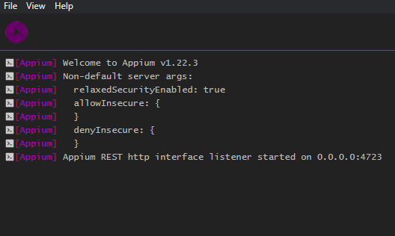
Appium Server
Before starting server
After starting Server

Slide 13
Implementation and Testing (Appium Inspector )
Give the Desired Capabilities in Appium Inspector.
It will start the session and gives you java code to start testing.
Paste the code in IntelliJ IDE and Start the Testing.

Slide 14
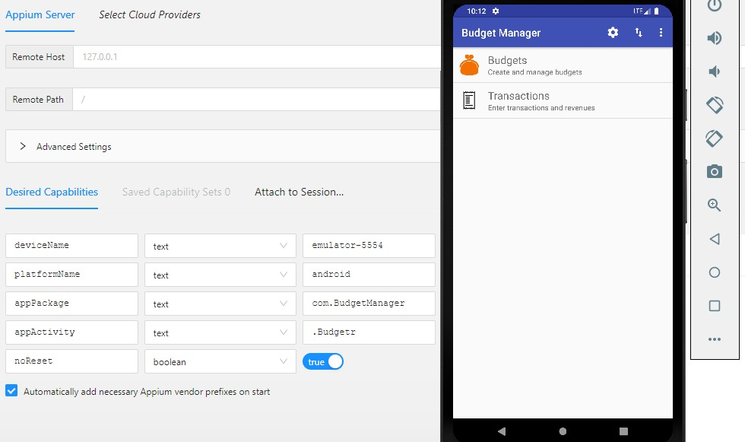
Testing OUTPUT

Slide 15
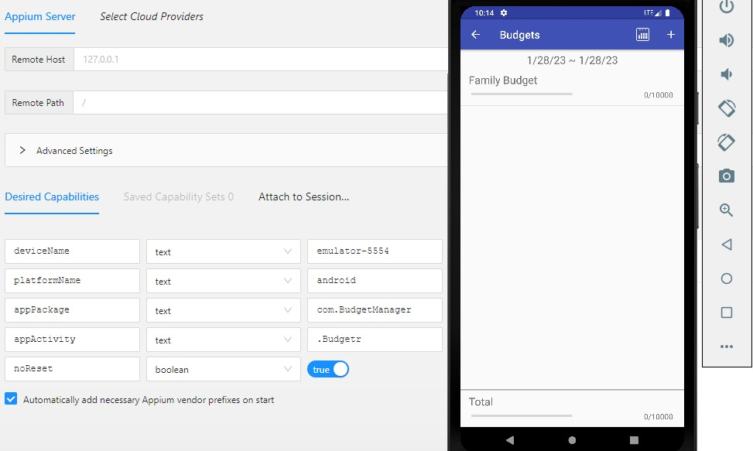
Testing OUTPUT

Slide 16
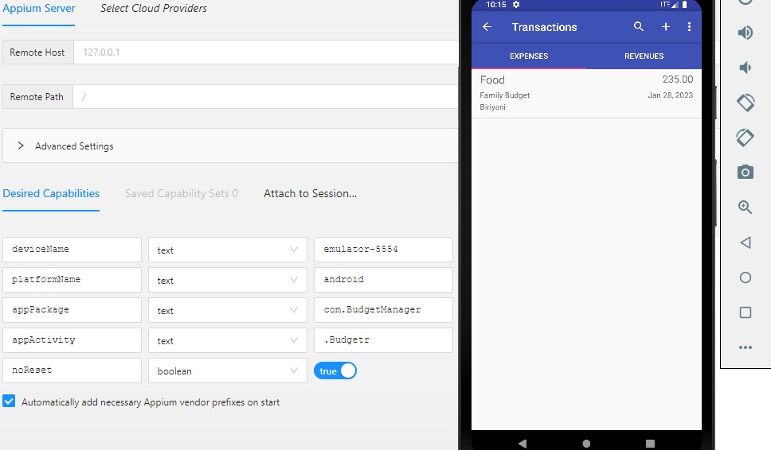
Testing OUTPUT

Slide 17
Test Case Outcomes
TEST CASES | OUTCOMES
Verify the user can add Revenue | Positive
Verify the user can check Expense | Positive
Verify the user can set Budget Date | Positive
Verify the user will get Receipt | Positive
Verify the user will get Bills | Negative
Verify the user can Input | Positive
Verify the user can Set Budget | Positive
Verify the user can do Transaction | Negative
Verify the user can Import/Export Budget receipts. | Negative
Verify the user can Access Camera/Calendar | Positive

Slide 18
Conclusion
All the Revenue , Expense, Budget Date and Possible Outcomes were Tested using the Appium Server.
70 Percentage of the Test cases were positive
30 percentage were negative.
By Generating Bills , Enabling Transactions and Importing and Exporting Bill receipts we can overcome all Negative Outcomes.

